Slide 1
The Transport Layer
TCP
Congestion Control

Slide 2
TCP congestion control: additive increase multiplicative decrease
approach: sender increases transmission rate (window size), probing for usable bandwidth, until loss occurs
additive increase: increase cwnd by 1 MSS every RTT until loss detected
multiplicative decrease: cut cwnd in half after loss
additively increase window size …
…. until loss occurs (then cut window in half)
AIMD saw tooth
behavior: probing
for bandwidth
cwnd: TCP sender
congestion window size
time

Slide 3
TCP Congestion Control: details
sender sequence number space
TCP sending rate:
roughly: send cwnd bytes, wait RTT for ACKS, then send more bytes
cwnd
last byte
ACKed
last byte sent
sent, not-yet ACKed
(“in-flight”)
rate
cwnd
sender limits transmission:
cwnd is dynamic, function of perceived network congestion
~
bytes/sec
~
RTT
LastByteSent-
LastByteAcked
cwnd
<

Slide 4

TCP Slow Start
Host A
Host B
when connection begins, increase rate exponentially until first loss event:
initially cwnd = 1 MSS
double cwnd every RTT
done by incrementing cwnd for every ACK received
summary: initial rate is slow but ramps up exponentially fast
one segment
RTT
two segments
four segments
time

Slide 5
TCP: detecting, reacting to loss
loss indicated by timeout:
cwnd set to 1 MSS;
window then grows exponentially (as in slow start) to threshold, then grows linearly
loss indicated by 3 duplicate ACKs: TCP RENO
dup ACKs indicate network capable of delivering some segments
cwnd is cut in half window then grows linearly
TCP Tahoe always sets cwnd to 1 (timeout or 3 duplicate acks)

Slide 6
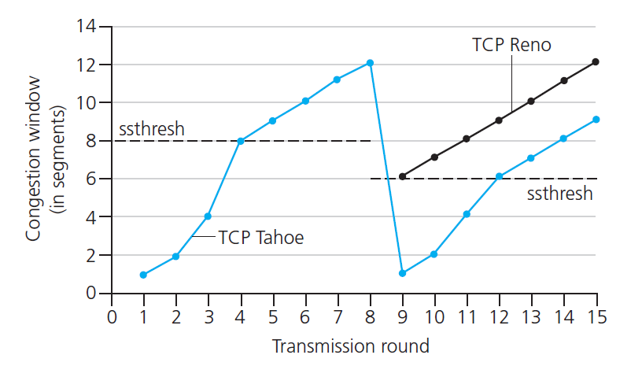
TCP: switching from slow start to CA
Q: when should the exponential increase switch to linear?
A: when cwnd gets to 1/2 of its value before timeout.
Implementation:
variable ssthresh
on loss event, ssthresh is set to 1/2 of cwnd just before loss event

